Slide 1

Unsupervised Learning Project
COVER SLIDE
Salva, Leah, Tara
March 2023

Slide 2

Project Flow
AGENDA SLIDE
LHL BOOTCAMP
01
EDA
02
Clustering by Demographics
03
Clustering by Behavior

Slide 3

3. Clustering by Customer Behavior
SECTION TITLE SLIDE
LHL BOOTCAMP

Slide 4
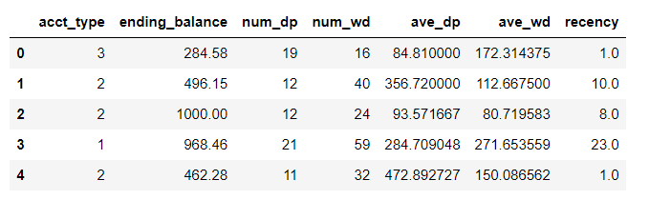
Data Frame for Clustering
DATA DRIVEN SLIDE
LHL BOOTCAMP

Slide 5
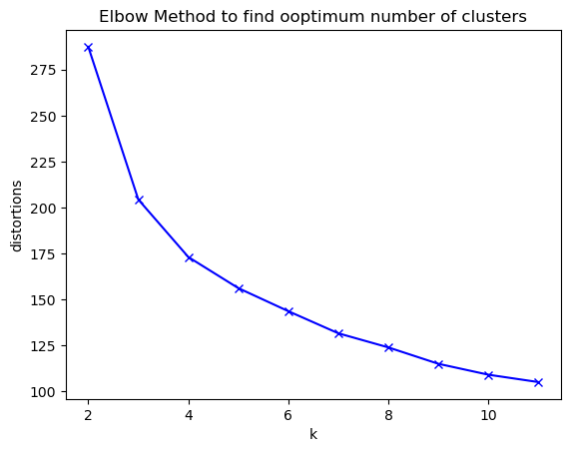
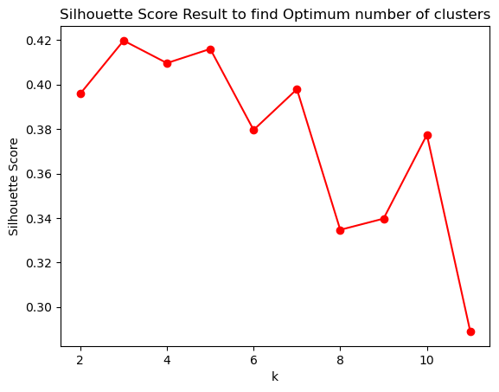
Select the Optimum K for Kmeans++
DATA DRIVEN SLIDE
LHL BOOTCAMP
Optimum K=3

Slide 6
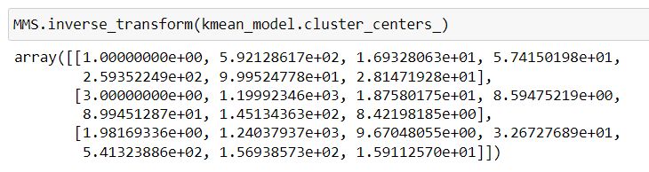
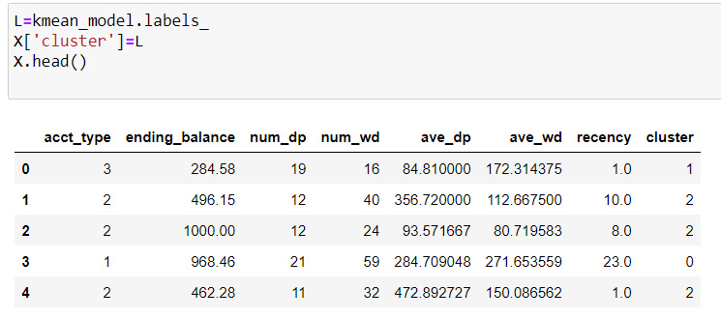
Summary of Results
DATA DRIVEN SLIDE
LHL BOOTCAMP
Data According to Their Cluster
Center of Clusters

Slide 7
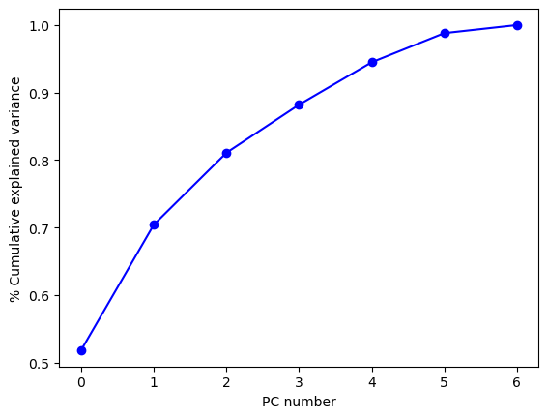
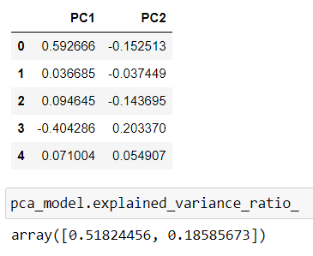
PCA Analysis
DATA DRIVEN SLIDE
LHL BOOTCAMP
Cumulative Variance for Different PCAs

Slide 8
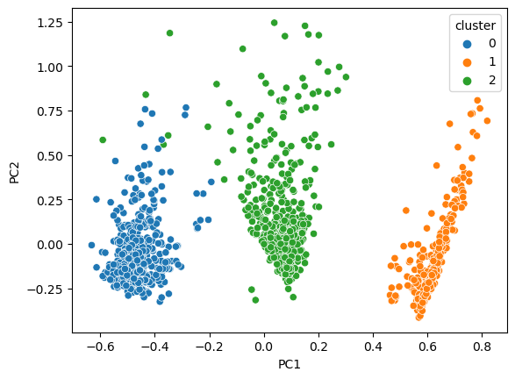
Cluster Visualization
DATA DRIVEN SLIDE
LHL BOOTCAMP
2D Scatter Plot for Clusters Using PCA

Slide 9
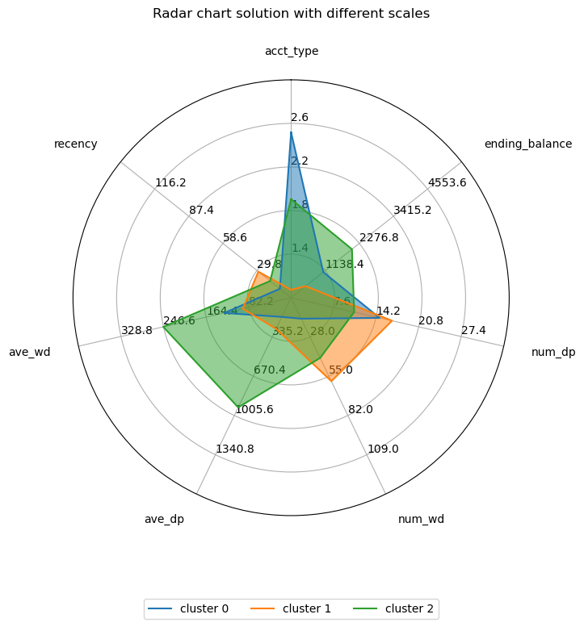
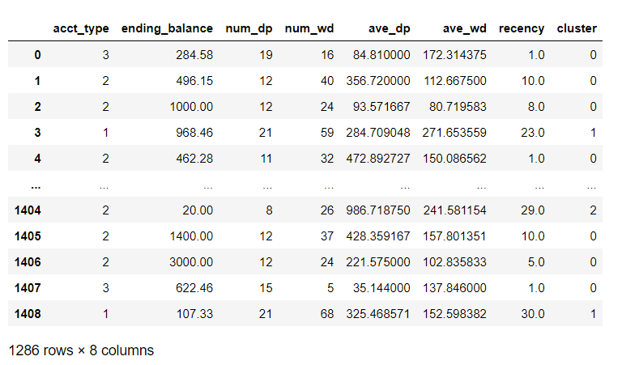
Cluster Visualization
DATA DRIVEN SLIDE
LHL BOOTCAMP
Radar Chart for Clusters
Data Frame with Clusters Number

Slide 10
Thank you.
END SLIDE

